Slide 1
Remittances between integration, transnationalism and development
Jørgen Carling
Migration and Development, European Migration Network Conference, Oslo, 18 June 2012

Slide 2
… research on the conditions for peaceful relations between states, groups and people

Slide 3

… research on the conditions for peaceful relations between states, groups and people
Migration and transnationalism
Peace and conflict
Theoretical and applied

Slide 4



Jørgen Carling
Research Professor
Remittances from Immigrants in Norway
Research Council of Norway
2007−2012
Marta Bivand Erdal
Senior Researcher
Cindy Horst
Senior Researcher
Associated researchers and assistants

Slide 5
Multi-method
Comparative
Two case studies
Survey data
Remittances from Immigrants in Norway
Research Council of Norway
2007−2012

Slide 6
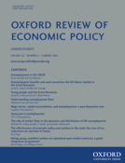
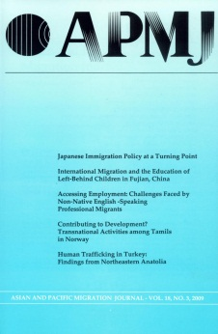
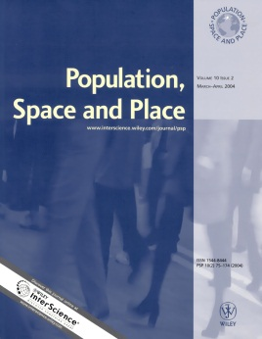
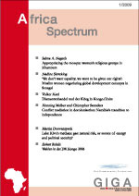
Remittances from Immigrants in Norway
Research Council of Norway
2007−2012

Slide 7
Remittances
INTEGRATION
TRANSNATIONALISM
DEVELOPMENT
Remittances from Immigrants in Norway
Research Council of Norway
2007−2012
Remittances

Slide 8

Remittances
Norway
Pakistan
INTEGRATION
TRANSNATIONALISM
DEVELOPMENT
Remittances

Slide 9
Remittances and transnationalism
TRANSNATIONALISM
Transnational practice
Senders and receivers
Moral dimensions
Change over time
Social remittances?

Slide 10
Remittances and integration
Norway
INTEGRATION
Suspicion
Transfer mechanisms
Do ‘good’ immigrants remit?

Slide 11
Remittances and development
Pakistan
Stunning facts
Overwhelming complexities
Hope and enthusiasm
DEVELOPMENT
Migration and Development
International Migration

Slide 12



Migration and development
Win | Win | Win
 |  |  | Recruitment
 |  |  | Remittances
 |  |  | Return

Slide 13
Remittances
Norway
Pakistan
INTEGRATION
TRANSNATIONALISM
DEVELOPMENT

Slide 14
Remittances
Attachment to the country
of origin
Attachment to Norway
Financial situation and employment
Individual characte-
ristics
Country of origin
Who remits?

Slide 15
Survey data
Attachment to the country
of origin
Attachment to Norway
Financial situation and employment
Individual characte-
ristics
Country of origin
Has parent(s) in country of origin
Has partner/spouse abroad
Owns property in country of origin
Has visited/received visits
Expects to return
Has not experienced discrimination
Has good Norwegian-language skills
Feels connected to Norway
Difficulties with regular expenses
Difficulty with unexpected expenses
Labour market position
Age
Proportion of life lived in Norway
Gender
Sends remittances at least once per year (yes/no)
Remittance-sending
Notes:
From the survey data, explanatory factors grouped under different headings
Country of origin: there are large differences between migrants from different countries who are similar in other respects
Can conflict or not in the country of origin explain these differences?

Slide 16




Survey data
Attachment to the country
of origin
Attachment to Norway
Financial situation and employment
Individual characte-
ristics
Country of origin
Remittance-sending

Slide 17
Survey data
Attachment to the country
of origin
Attachment to Norway
Financial situation and employment
Individual characte-
ristics
Country of origin
Separate analyses for Pakistanis and Somalis
Remittance-sending

Slide 18
Survey data
Attachment to the country
of origin
Attachment to Norway
Financial situation and employment
Individual characte-
ristics
Remittance-sending

Slide 19
Financial situation and employment
Carling, J., Erdal, M.B. and Horst, C. (2012) ‘How does conflict in migrants’ country of origin affect remittance-sending? Financial priorities and transnational obligations among Somalis and Pakistanis in Norway.’ International
Migration
Review, 46(2).
Somalis
  Household finances
  Labour market status
  Social obligations
  Urgent needs
Pakistanis
  Household finances
  Labour market status
  Perceived affordability
  Tradition and culture

Slide 20
Conclusions
Connections: integration−transnationalism−development
Remittances: lens on connections
Migration and development: beyond the pendulum?

Slide 21
Thank you!
www.prio.no/migration

