Slide 1
Current Trends in view of the UN High Level Dialogue
Malin Frankenhaeuser‌ Programme Manager Migration and Development ‌‌‌ Oslo, 18.06.2012

Slide 2
UN Migration and Development Process
1st UN High-level Dialogue on Migration and Development in 2006
  First high-level event organized by the GA devoted exclusively to the issue of international migration
  UN Secretary-General and his Special Representative on International Migration and Development proposed the creation of the GFMD
  Global Migration Group (GMG): coherence between the UN system and IOM
One-day Informal Thematic Debate on International Migration and Development in May 2011
67th session of the GA in December 2012 on the HLD modalities and themes
2nd UN High-level Dialogue on Migration and Development in September 2013
69th session of the GA in 2014: Cairo twenty years later “ICPD+20”
Commission on Population and Development (ECOSOC), Cairo 1994
  New trends in migration: Demographic Aspects (2013)
  Assessment of implementation of the Cairo Programme of Action (2014)

Slide 3

The GFMD – an outcome of the UN HLD 2006
Voluntary, informal, non-binding and government-led process open to all States Members and Observers of the United Nations
Civil society representatives are invited to hold parallel meetings and share their deliberations with state
Belgium (2007), Philippines (2008), Greece (2009), Mexico (2010), Switzerland (2011)
Chair of the GFMD 2012: Mauritius
Central theme: Enhancing the human development of migrants and their contribution to the development of communities and states
Roundtables:
  Circulating Labour for Inclusive Development
  Factoring Migration into Development Planning
  Managing Migration and Migrant Protection for Human Development Outcomes

Slide 4
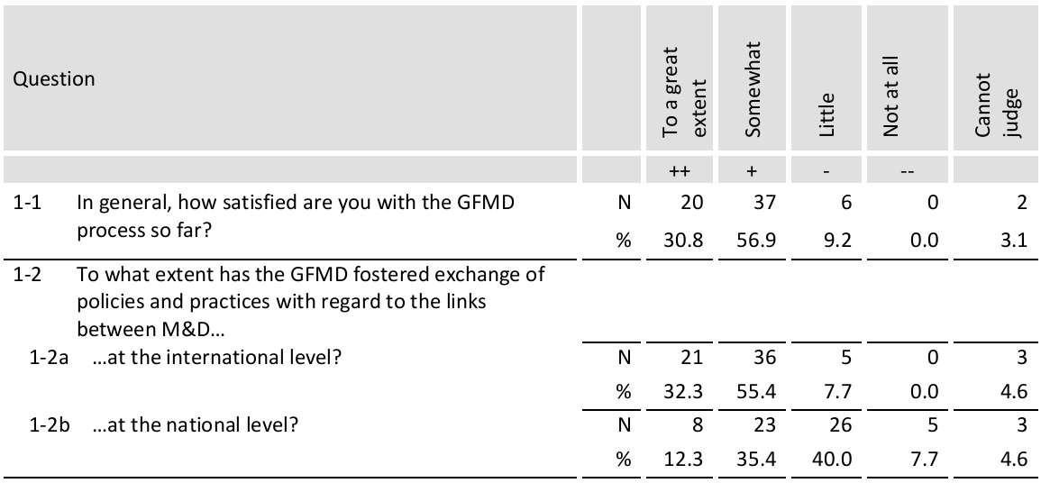
Assessment of the GFMD process

Slide 5
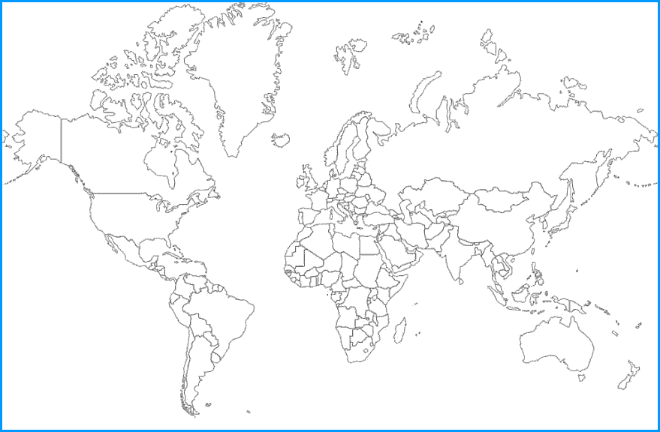
Countries in the GFMD process
Andorra
Austria
Belgium*
Denmark
Estonia
Finland
France*
Germany*
Greece*
Hungary
Ireland
Italy
Liechtenstein
Netherlands*
Portugal
Slovenia
Spain
Sweden*
Switzerland*
United Kingdom*
Finland
Sweden
Canada
UK
France
Spain Greece
USA
Mexico
Morocco
India
UAE
Qatar
Philippines
Nigeria
Kenya
Thailand
Indonesia
Mauritius
South Africa
Australia
Argentina

Slide 6
Commitments and driving the process forward
Furthering dialogue and exchange of good practices = active governments
Voluntary funding arrangement and hosting the Forum
Steering Group, “decision-making”
Focal points and level of participation (inter-ministerial coordination at home?)
Civil Society:
  Multitude of actors and wills (Migrants’ rights, PGA)
  Private sector involvement
  Development NGOs
  Academia
Thematic discussions:
  Development for whom? Move to human development, a capabilities approach
  Bringing irregular migration to the agenda (Mexico and Switzerland)
  Data, research → Policy coherence

Slide 7
Outlook and summary of the 10th Coordination Meeting on International Migration (February 2012)
Growing importance of South-South Migration, regional migration
Better involvement of diaspora in migration and development affairs
Protection of human rights – great concern of source countries of migrants
Migration and environmental change
Revision of the MDGs: inclusion of migration?
➔ Renewed discussion on migration in the UN framework: stronger role of the GFMD, UN migration institution, closer cooperation of UN agencies on migration…

Slide 8
Trends
Increasing number of conferences, meetings and workshops on M&D (GAMM 2012, UN HLD 2013, MDGs 2015)
Migration policies – Development policies
  Policy coherence (education, trade, investment...)
  Integrating migration into development planning (national, local)
  Internal migration, urban development (climate change adaptation)
  Dual citizenship and portability of social benefits
International organisations and regional frameworks
  Strengthening the GMG (IOM, ILO, UNDP, WB, UNICEF, UN Women...)
  Regional mobility: Regional Economic Communities (RECs), Regional Organisations
GFMD and/versus Regional migration dialogues/processes
Irregularity and (silent) regularisations
  Obama administration’s DREAM Act provide relief from deportation to as many as 1.4 million non-US citizens under the age of 30 (MPI)

Slide 9
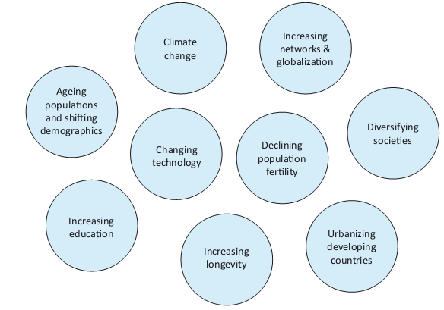
Megatrends for Future International Migrations
IMI 2011

Slide 10

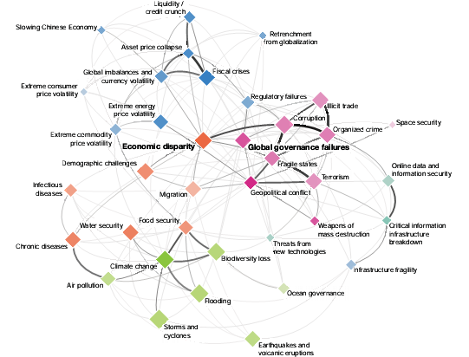
Global Risks (World Economic Forum)
IMI 2011

Slide 11
Thank you very much for your attention!

Slide 12
Malin Frankenhaeuser
Programme Manager Migration and Development
Phone: +43 1 504 46 77 23 54
Fax: +43 1 504 46 77 23 75
E-mail: malin.frankenhaeuser@icmpd.org
Gonzagagasse 1, 5th floor
1010 Vienna
Austria
www.icmpd.org

